Slide 1

2025
PM1 & PM2
Statewide Assessments
Training Materials
Elementary

Slide 2
Test Security Review
Per Test Security Statute, s. 1008.24, F.S., and Florida State Board Rule, 6A-10.042, Florida Administrative Code (FAC), inappropriate actions by school or district personnel can result in student or classroom invalidations, loss of teaching certification, and/or involvement of law enforcement.
Examples of prohibited activities are:
Reading or viewing the passages or test items before, during, or after testing
Copying the passages or test items
Revealing the passages or test items
Explaining the passages or test items for students
Changing or otherwise interfering with student responses to test items
Copying or reading student responses
Causing achievement of schools to be inaccurately measured or reported

Slide 3
Test Security
Policies and Procedures
Test administrators should report possible breaches of test security (e.g., secure test content that has been photographed, copied, or otherwise recorded) to the school assessment coordinator immediately.
If a security breach is identified, the school assessment coordinator must contact the district assessment coordinator.
For any test irregularities that require further investigation by the district, a written report must be submitted within 10 calendar days after the irregularity or security breach was identified.

Slide 4
Test Security
Policies and Procedures
After ANY administration, initial or make-up, all secure materials must be returned immediately to the school assessment coordinator and placed in locked storage.
No more than three people should have access to the locked storage room. Secure materials must never be left unsecured and must not remain in classrooms or be taken off the school’s campus overnight.
The Test Materials Chain of Custody Form for Grades 3-6 paper-based materials must be maintained at all times.

Slide 5
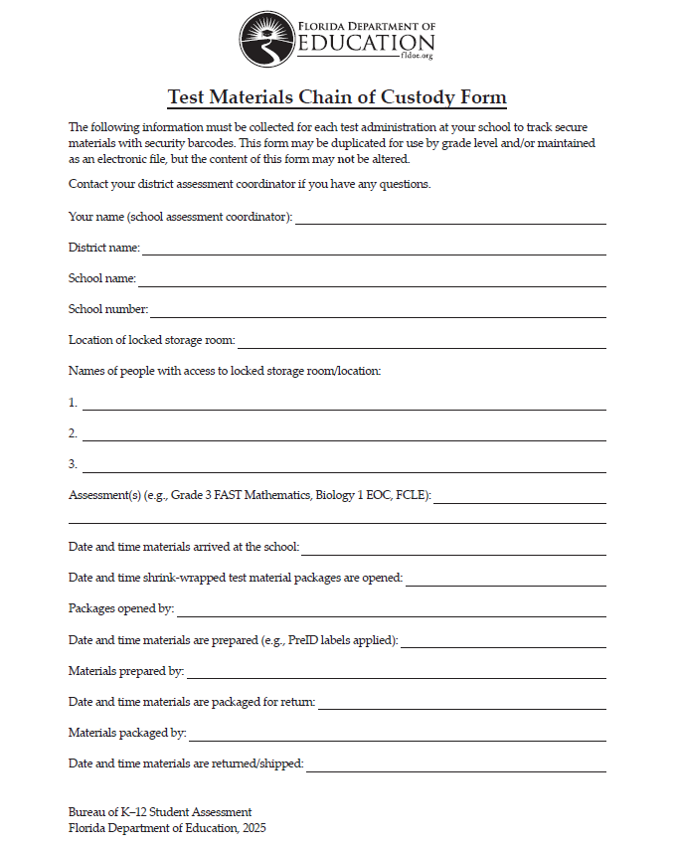

Slide 6
Test Security
Policies and Procedures
All personnel are required to sign and return a Test Administration and Security Agreement stating that they have read and agree to abide by all test administration and test security policies and procedures.
Test administrators must sign the Test Administrator Prohibited Activities Agreement, located in the manuals.

Slide 7
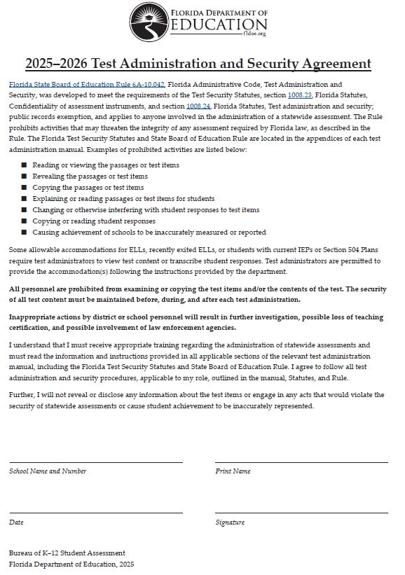
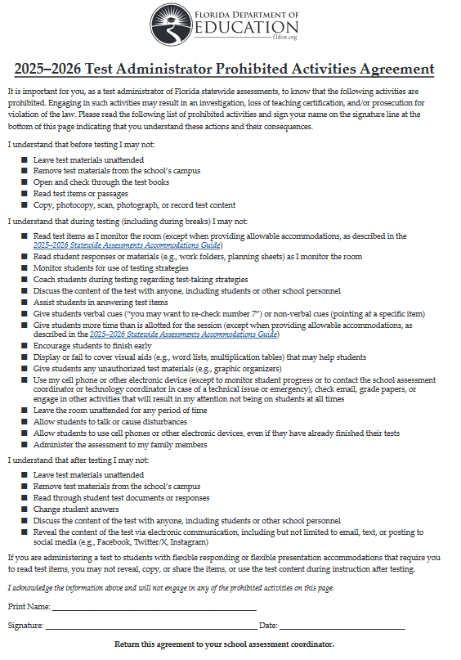

Slide 8
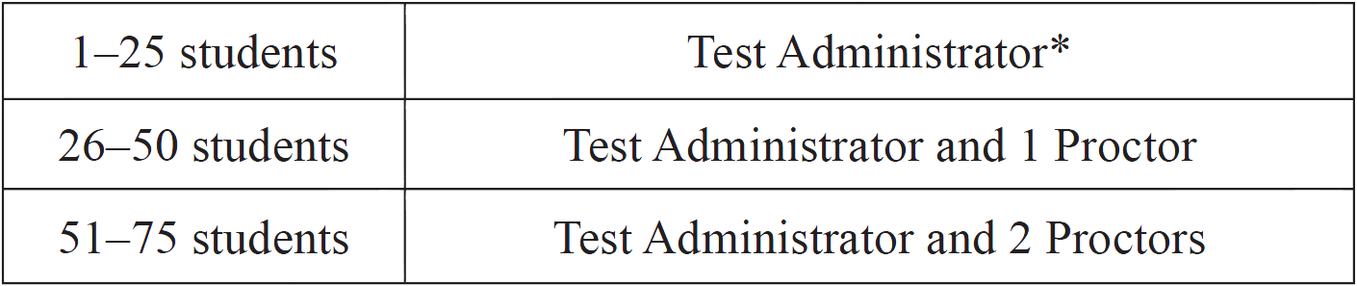
Test Security
Policies and Procedures
Proctors (Grades 3-6)
The appropriate number of proctors MUST be assigned to the room to assist the test administrator. Refer to the table below for the required number of proctors.
* FDOE strongly recommends that proctors be assigned to rooms with 25 or
fewer students whenever possible.

Slide 9
Test Security
Policies and Procedures
Proctors (cont.)
School personnel and non-school personnel may be trained as proctors. Prior to testing, inform all proctors of their duties and of the appropriate test security policies and procedures. School personnel proctor duties may include preparing and distributing secure materials (e.g., test tickets).
Non-school personnel may assist test administrators during test administration; however, they may NOT participate in any of the test administration procedures (e.g., distributing and collecting test materials, providing accommodations).

Slide 10
Test Security
Policies and Procedures
Under no circumstances are students permitted to assist in preparing secure materials before testing or in organizing and returning materials after testing.
Test administrators and Proctors must NOT administer tests to their family members. Students related to their assigned test administrator should be reassigned to an alternate test administrator. In addition, a student’s parent/guardian should not be present in that student’s testing room.
Any monitoring software that would allow test content on student workstations to be viewed on another device during testing must be turned off.

Slide 11
Paper-Based Testing
Policies and Procedures
Response Entry Interface – REI (Grades 3-6)
All regular print, large print, and one-item-per-page FAST paper-based assessments must be transcribed by school staff into the REI (must have School Data Entry (SDE) role in TIDE).
Each test should be transcribed by one staff member, and another staff member should confirm the transcription prior to the test being submitted.
Responses should be entered into the REI within one week of the student completing the paper-based assessment.
More information about the REI can be found in the REI User Guide on the FSA Portal.

Slide 12
Paper-Based Testing
Policies and Procedures
Star Record Book (Grades K-2)
All regular print, large print, and one-item-per-page K-2 FAST paper-based assessments must be transcribed by school staff into the Star Record Book.
Responses should be entered into the Record Book within one week of the student completing the paper-based assessment.
More information about this can be found in the K-2 FAST Paper-Based Star Assessments User Guide on the FSA Portal.
Follow the instructions in the user guide to return materials.

Slide 13
Test Invalidation
Policies and Procedures
A student has an electronic device during testing. If a student is found with an electronic device that he or she is not using for testing purposes during testing or during breaks within a session, the student’s test must be invalidated.
A student is given unauthorized help during testing. If a student received unauthorized assistance or has been given an unfair advantage (e.g., a test administrator has told a student to check the answer to a specific item), the student’s test must be invalidated.
A student is caught cheating during testing. In situations involving cheating, a report must be submitted to FDOE within 10 calendar days of the incident.

Slide 14
Test Invalidation
Policies and Procedures
A student is given an unauthorized accommodation. Testing with accommodations not indicated on a student’s IEP, 504 plan, or ELL plan may be cause for invalidation.
A student was not provided an allowable accommodation. The situation should be discussed with the student and parents to determine if the lack of the accommodation significantly affected the student’s performance and if the test should be scored.
A student is given an unauthorized aid. For instance, if a student had access to an unauthorized visual aid, the aid in question should be considered in terms of its likely impact on the validity of results.

Slide 15
Test Invalidation
Policies and Procedures
A student becomes ill during testing. If a student reports after testing that he or she was ill during testing and was significantly affected, the test may be invalidated. If a student is unable to complete a session due to illness, the session may be completed on a subsequent day using the exact time that the student had remaining.
A disruption occurs during testing. If students are disrupted during testing due to a circumstance out of their control (e.g., severe weather), test invalidation may be considered if a student feels his or her performance was significantly affected by the disruption.

Slide 16
Test Invalidation
Policies and Procedures
Invalidations (Grades 3-6)
For computer-based assessments, test invalidations are entered in TIDE. Invalidating a test will require the student’s ID number and the reason for invalidation.
If a paper-based test needs to be invalidated, it should still be entered into the REI, then invalidated in TIDE.
Follow the instructions in the Accommodations Guide to return paper-based materials.
Deactivations (Grades K-2)
Use our Deactivation Google Form to request deactivations. Contact Charlie Henderson for more info.

Slide 17

Florida Statewide Assessments
PM1 & PM2
Grades K-2 FAST Early Literacy / Reading
Grades K-2 FAST Math
Grades 3-6 FAST Reading
Grades 3-6 FAST Math

Slide 18

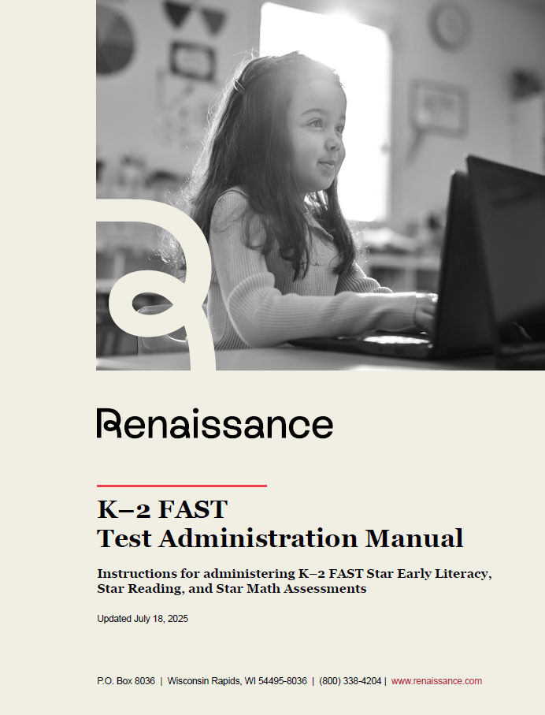
Test Administration Resources
Policy Information
Instructions
Scripts
Signs & Forms

Slide 19
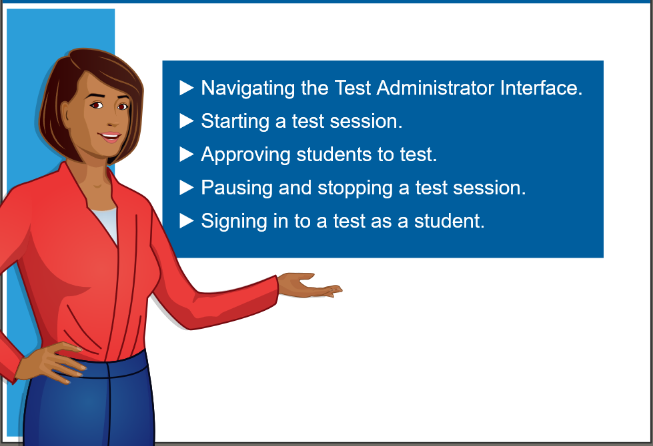
Test Administration Resources
TDS User Guide/Quick Guide
TIDE User Guide/Quick Guide
Accommodations Guides
REI User Guide
K-2 FAST PBT User Guide
TA Certification Course
Florida Assessment Portal – www.flfast.org
Renaissance Help Center – https://support.renaissance.com
Evaluation Services Website – www.escambiaschools.org/eval
Google Classroom – Email Heather for access

Slide 20
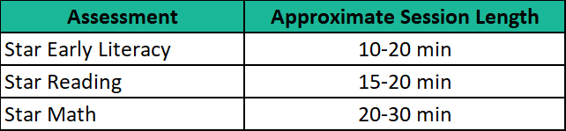
Test Administration Schedule
Grades K-2 Early Literacy, Reading & Math
Star assessments have only 1 session.
Students can only take one subject test per day.
Only students with an accommodation can have extended or unlimited time.
K-2 ELL’s get unlimited time.

Slide 21
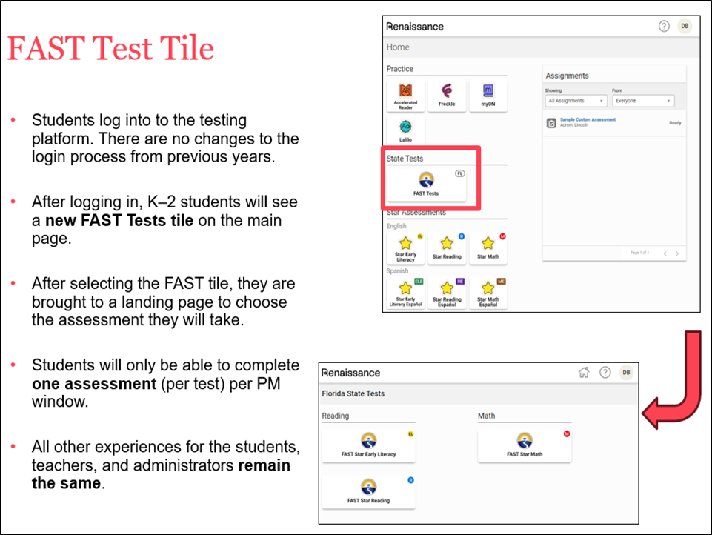
Test Administration - NEW
Grades K-2 NEW FAST Tests Tile

Slide 22
Test Administration Schedule
Grades K-2 Early Literacy/Reading Guidance
All students in Kindergarten and First Grade will take Star Early Literacy in PM1, unless a First Grade student scored 852 or higher in the previous school year, then you may administer Star Reading beginning in PM1.
Students who receive a Scaled Score of 852 or higher on Star Early Literacy should be assessed using Star Reading beginning with the next progress monitoring (PM) window.
First Grade students during PM3 and Second Grade students during all three PM windows must attempt Star Reading.
If the student does not pass the practice items after two attempts, the district should administer Star Early Literacy to the student to gain additional instructional information.

Slide 23
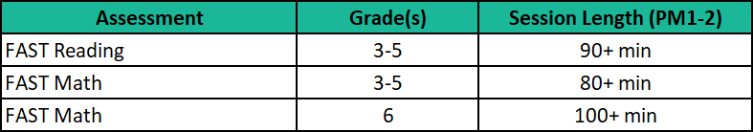
Test Administration Schedule
Session Lengths by Subject
FAST Reading and Math Grades 3-6
FAST assessments have only 1 session.
Students can only take one subject test per day.
Any student who has not completed the test by the end of the allotted time may continue working up to the length of a typical school day.

Slide 24
Test Materials
Headphones
Headphones are required for all K-2 Star Early Literacy, Reading and Math tests.
Star Math Audio preference is enabled for all K-2 students.
If students are assigned any accommodations under the Accommodations Preference in the Renaissance platform for Star Math (including Unlimited Time), the school must manually enable the Audio – Accommodations option to provide audio support for the student.
Four-function Calculators
The Grade 6 FAST Math test includes a four-function calculator in the TDS, and approved handheld calculators are optional.

Slide 25
Test Materials
Pens/Pencils & Scratch Paper – FAST Math
Grades K-6 students taking FAST Math must be provided with a pen or pencil and blank scratch paper to work the problems. Grid/graph paper may be provided as scratch paper.
Grades 3-6 scratch paper must be collected and returned in the District Assessment Coordinator ONLY box.
Reference sheets – Grades 4 & 5 FAST Math
Reference Sheets are provided in an online format for computer-based testing. They are displayed in pop-up windows in their respective tests.
Hard Copies are optional but used reference sheets must be collected and returned in the District Assessment Coordinator ONLY box.

Slide 26

School Assessment Coordinator
Before Testing
Preparation and Training
You are responsible for training all test administrators and proctors. In the absence of sufficiently trained administrators, postpone testing until trained personnel are available.
Test administrators must read and be familiar with all appropriate sections of the manuals.
Test Administrators are required to ACTIVELY monitor students while testing.
Test Administrators must check for and remove all unauthorized visual aids posted in classrooms or affixed to student desks prior to testing.
Remember to post the appropriate testing signs provided in the manual.

Slide 27
School Assessment Coordinator
Before Testing
Preparation and Training (cont.)
Electronic Devices and Breaks
  Determine your school’s policy for the storage of electronic devices during testing.
  Ensure that test administrators are aware of the policy that students are not allowed to access electronic devices at any time during a test session, including breaks. If a student accesses his or her electronic device(s) during a break, his or her test must be invalidated.
  Ensure test administrators are aware of how to secure a student’s computer or device during a break. For longer breaks, it is recommended that the student pause the test.

Slide 28
School Assessment Coordinator
Before Testing
Prepare for CBT Administration
Ensure that all test administrators have active usernames and passwords to log in to TIDE. Test administrators will need access to the TA Interface in TIDE to administer tests.
Make sure that all your students are showing correctly in TIDE. You may need to manually add some students. Verify that student eligibility is correct and that accommodations and test settings are correct.
The Florida Education Identifier (FLEID) is now required when adding a student to TIDE.
Create Rosters as needed.
For the K-2 students, be sure to Assign Products to Courses before the window opens so that you are ready to test.

Slide 29
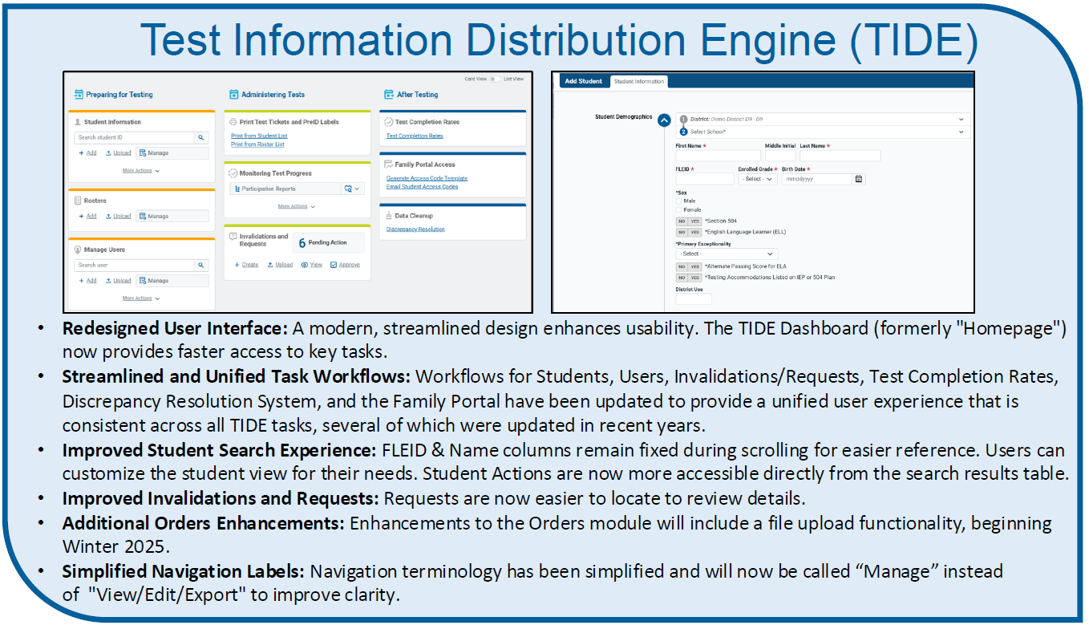
TIDE Updates
Prepare for CBT Administration

Slide 30
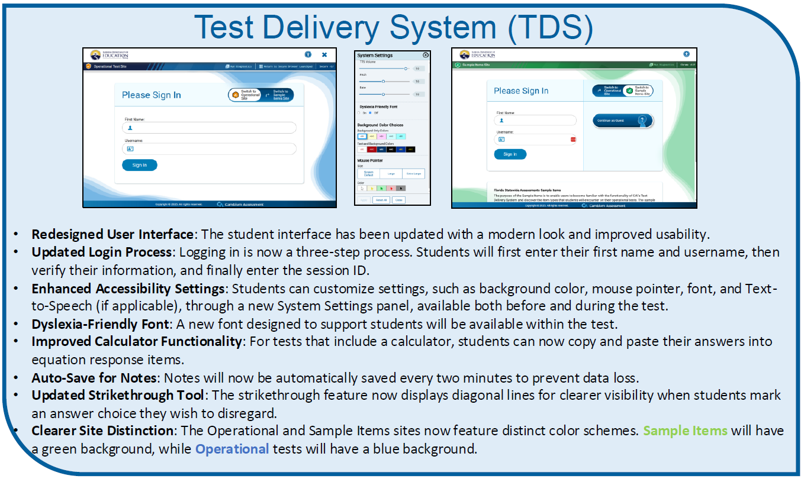
TDS Updates

Slide 31
School Assessment Coordinator
Before Testing
Meet with your Technology Coordinator
It is important that technology coordinators understand their responsibilities before, during, and after a computer-based test administration.
The latest version of the secure browser must be installed on all computers or devices that students will use for testing.
Review the instructions and information for technology coordinators, as well as all test administration and security policies and procedures included in the manual, with your technology coordinator and create a plan for handling issues during testing.

Slide 32
School Assessment Coordinator Before Testing
Print Test Tickets (Grades 3-6)
Each student must have a test ticket to log in to computer-based assessments.
See the TIDE user guides for instructions on generating and printing test tickets.
Prior to computer-based test administrations, print test tickets to distribute to test administrators.
Test tickets are considered secure materials and must be stored in a secure location before and after testing and returned in the District Assessment Coordinator ONLY box.

Slide 33
School Assessment Coordinator
Before Testing
Print On-Demand PreID Labels for PBT (Grades 3-6)
PreID Labels must be printed and applied to paper-based test and answer books.
Instructions for printing PreID labels are in the TIDE User Guide.
School staff may verify and apply labels no sooner than one week prior to testing.

Slide 34
School Assessment Coordinator
Before Testing
Ensure Implementation of Accommodations
The Accommodations Guide provides information concerning allowable accommodations for students with disabilities and for ELLs.
When testing students with accommodations, prior planning is necessary to ensure that accommodations indicated on student IEPs, Section 504 plans, or ELL plans are implemented. Arrangements for implementing accommodations must be made prior to the administration dates.
Make sure that test administrators have been properly trained regarding accommodations and have made provisions for the exact accommodations needed for individual students to avoid test invalidations.

Slide 35
School Assessment Coordinator Before Testing
Ensure Implementation of Accommodations (cont.)
In TIDE and Renaissance, ensure the appropriate accommodations by selecting them on the student details page.
This must be done before testing.
Detailed instructions are given in the TIDE User Guide and Renaissance Help Center.
Accommodated scripts are available on the Florida Assessment Portal.

Slide 36
School Assessment Coordinator
Before Testing
Required Administration Information (Grades 3-6)
Communicate to test administrators the process for collecting the required administration information, which includes the following:
  Subject
  Session ID
  Grade level
  Student Names and ID Numbers
  Attendance information
    (P=Present, A=Absent, W=Withdrawn, and P/I=Present but Invalidated)
  Accommodations Provided AND accommodations Used
  Signatures of test administrator and school assessment coordinator
  Security numbers of PBT documents assigned to each student

Slide 37
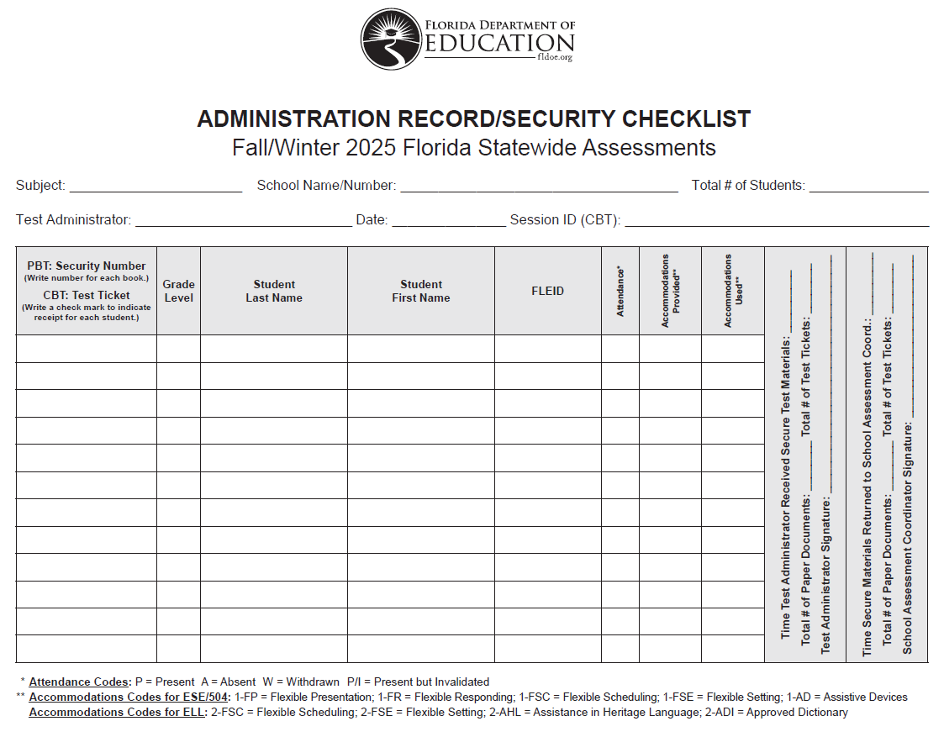

Slide 38
School Assessment Coordinator
Before Testing
Security Log (Grades 3-6)
Each test administrator is required to maintain an accurate Security Log, provided in the testing manuals.
Anyone who enters a testing room for any length of time is required to sign the log.
This applies to test administrators, proctors, and anyone who relieves a test administrator, even for a short break.

Slide 39
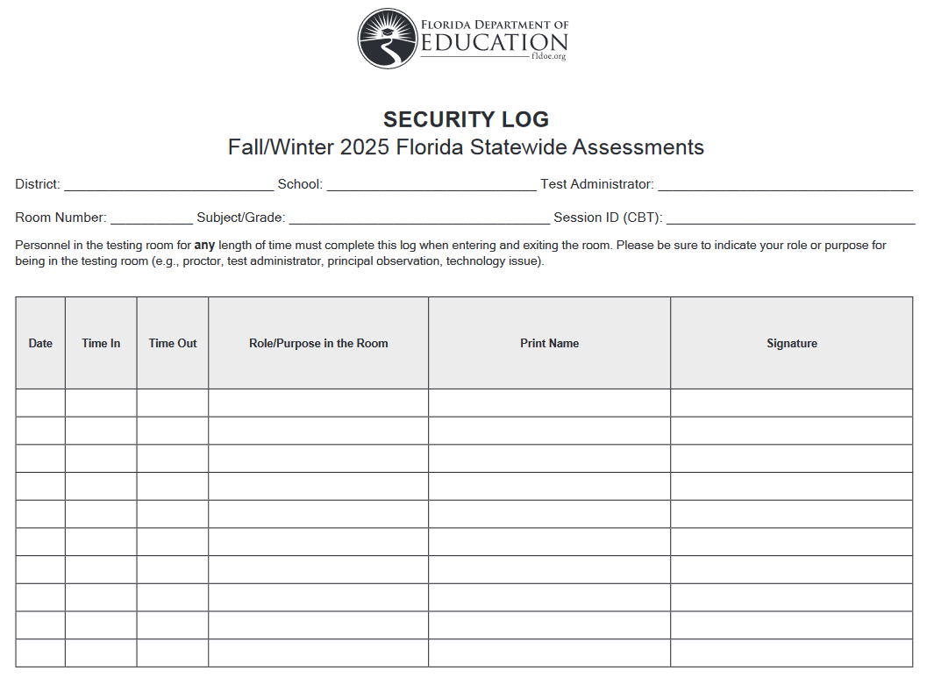

Slide 40
School Assessment Coordinator
Before Testing
Seating Charts (Grades 3-6)
Test administrators are required to maintain an accurate seating chart for each group of students testing, and should include the following:
  Test Administrator name
  Date
  Subject
  Session ID
  Room number
  Start/Stop times
  Student names and locations
  Arrow showing direction students are facing
  Chromebook ID if there were technical issues

Slide 41
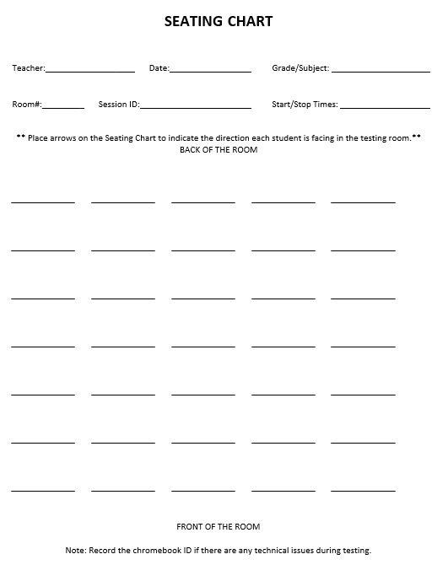

Slide 42
School Assessment Coordinator
During Testing
Distribute Test Materials (Grades 3-6)
On each day of testing, you are responsible for providing each test administrator with the following test materials, as applicable:
Test tickets
Administration Record
Security Log
Seating Chart
Pens/Pencils & Scratch Paper
Test and answer books or special document materials (PBT)

Slide 43
School Assessment Coordinator
During Testing
Supervise Test Administration and Maintain Test Security
Provide test administrators with additional materials during testing, as necessary.
Monitor each testing room to ensure that test administration and test security policies and procedures are followed.
You and the technology coordinator must be available during testing to answer questions from test administrators and to assist with technical issues. The test administrator must have a way to contact the school assessment coordinator or technology coordinator without leaving the room unattended.
Ensure that Admin Records, Security Logs and Seating Charts are being completed properly and that all required administration information is being maintained in each testing room.

Slide 44
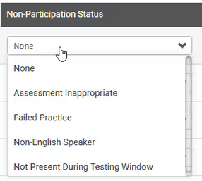
School Assessment Coordinator
During Testing
Monitor Student Progress
Use reports in TIDE and Renaissance to track completion rates and determine which students still need to be tested.
Further information on reports can be found in the TIDE User Guide and Renaissance Help Center.
Submit requests to re-open and restart tests in TIDE when necessary and email Nate and Heather. We are not notified when these requests are submitted.
Mark Non-Participation for K-2 students that do not test.

Slide 45
School Assessment Coordinator After Testing
Receive Materials from Test Administrators
  Verify that all secure materials have been returned to you after testing.
  Make copies of the following documents:
    Sign-In sheets from your training
    Signed Security Agreements
    Signed Prohibited Activities Agreements
    Administration Records
    Security Logs
    Seating Charts
    Chain of Custody Forms for PBT (if any)
Retain your copies and return the originals to Evaluation Services in your Security Box.

